Slide 1





DETECTING HEART DISEASE WITH MACHINE LEARNING ALGORITHMS
PRESENTER: NGUYEN NGOC HAI

Slide 2
OUTLINES
About heart disease
Used ML Algorithms
Dataset
Code implementation

Slide 3



1. About heart disease

Slide 4

1. About heart disease
The term "heart disease" generally refers to conditions that involve narrowed or blocked blood vessels that can lead to a heart attack, chest pain (angina) or stroke.

Slide 5
Machine Learning can play an essential role in predicting presence of heart diseases and more.

Slide 6
2. Used ML Algorithms

Slide 7
2. Used machine learning algorithms
XGBoost
Stands for eXtreme Gradient Boosting
Based on decision trees
Used for supervised learning
Ensemble learning method
Great speed & performance
Random forest
Ensemble learning method
Used for supervised learning
Consists of many decision trees

Slide 8
3. Dataset

Slide 9
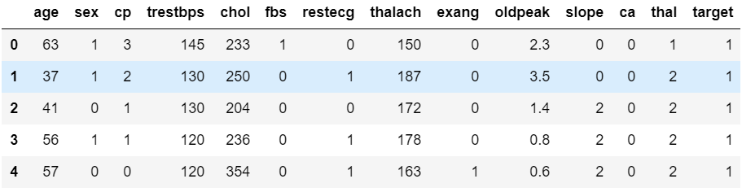
3. Dataset
Name: ‘Heart disease UCI’
< https://www.kaggle.com/ronitf/heart-disease-uci/data>
Has 14 columns
First 5 rows of the dataset

Slide 10
3. Dataset
Name: ‘Heart disease UCI’
Has 14 columns
#1: age | age in years | #8: thalach | maximum heart rate achieved
#2: sex | 1 = male; 0 = female | #9: exang | exercise induced angina (1 = yes; 0 = no)
#3: cp | chest pain type | #10: oldpeak | ST depression induced by exercise relative to rest
#4: trestbps | resting blood pressure (in mm Hg on admission to the hospital) | #11: slope | the slope of the peak exercise ST segment
#5: chol | serum cholestoral in mg/dl | #12: ca | number of major vessels (0-3) colored by flourosopy
#6: fbs | (fasting blood sugar > 120 mg/dl) (1 = true; 0 = false) | #13: thal | 3 = normal; 6 = fixed defect; 7 = reversable defect
#7: restecg | resting electrocardiographic results | #14: target | 1 = yes; 0 = no

Slide 11








4. Implementation

Slide 12
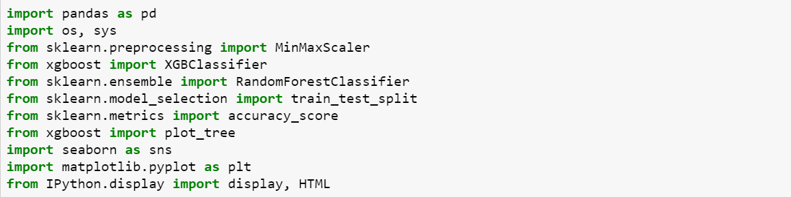
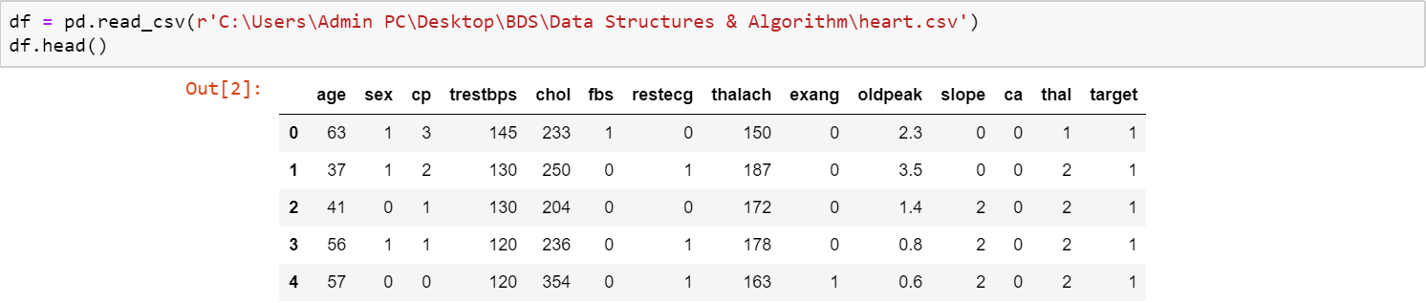
4.1: Import required libraries
Read data into Dataframe

Slide 13
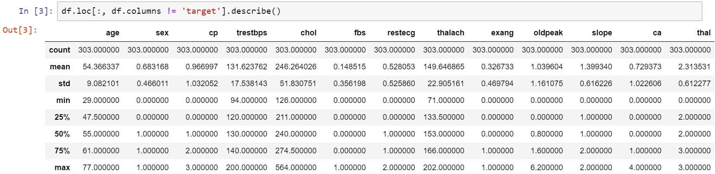
4.2: Data exploration:
Check statistics about the data

Slide 14
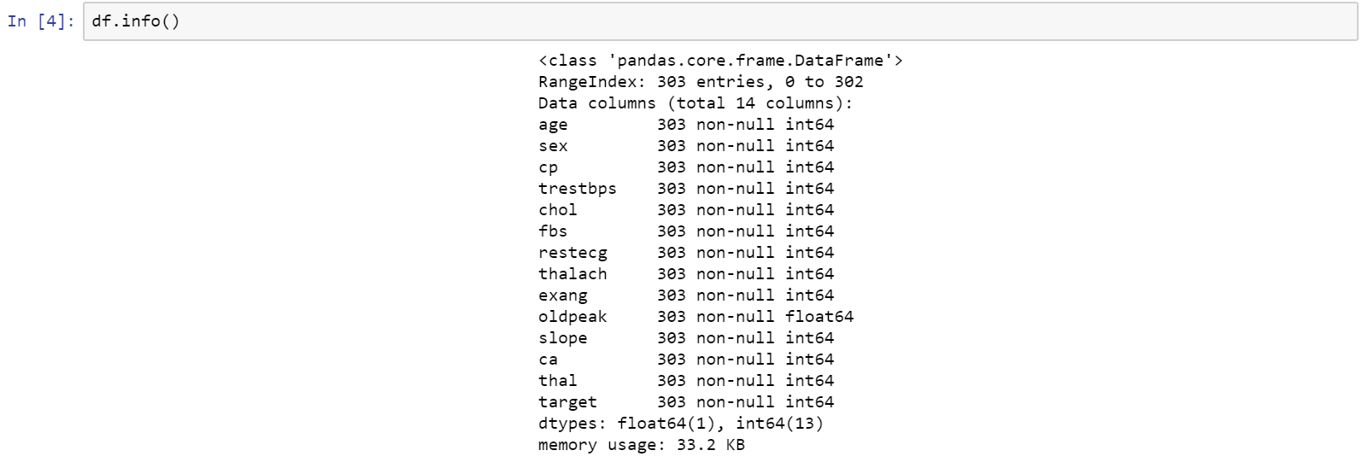
4.2: Data exploration:
Check for null values

Slide 15
4.2: Data exploration:
The dataset is approximately balanced, which is good enough for the model to proceed

Slide 16
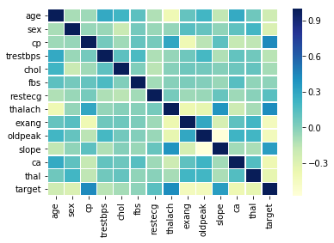
CORRELATION MATRIX
Correlation matrix:
Gives information about the correlation between each variable of the dataset
The darker the color is, the more correlated the variables are.
3 variables that are highly correlated: cp, thalach and slope.

Slide 17
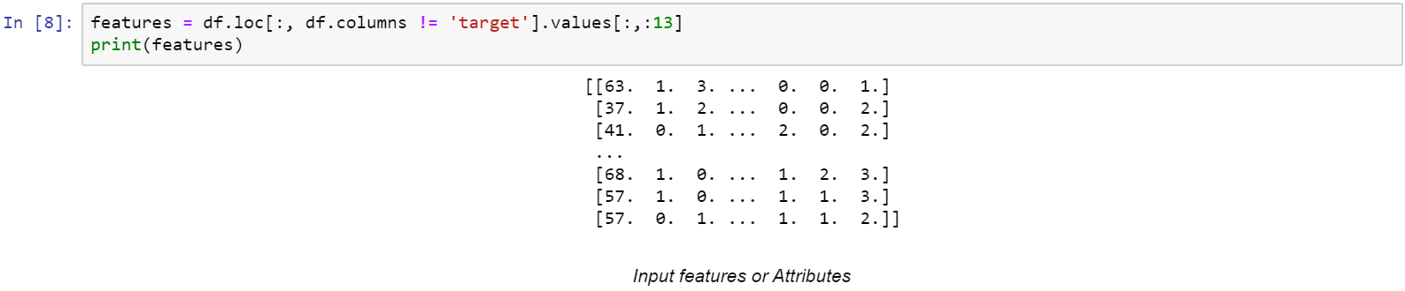
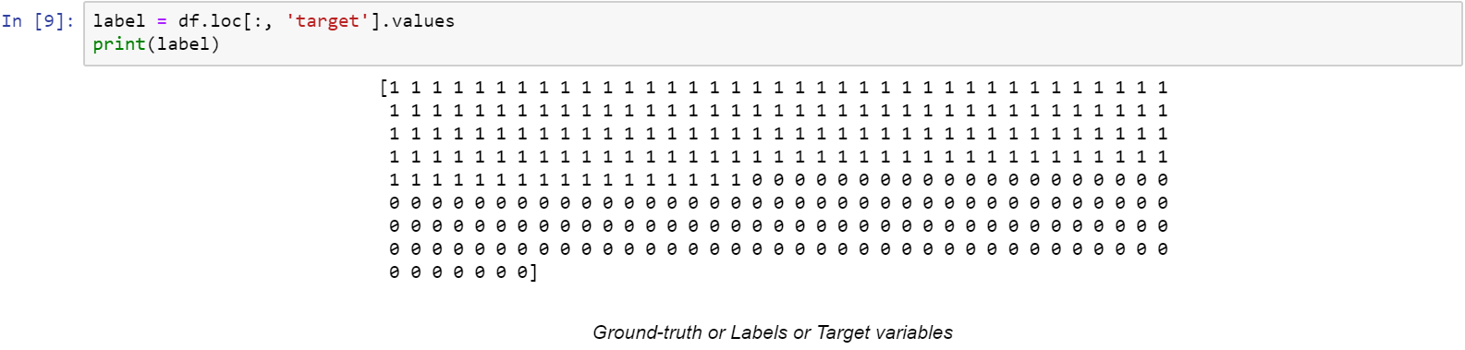
4.3: Data preparation
Get features from Dataframe
Get labels from Dataframe

Slide 18
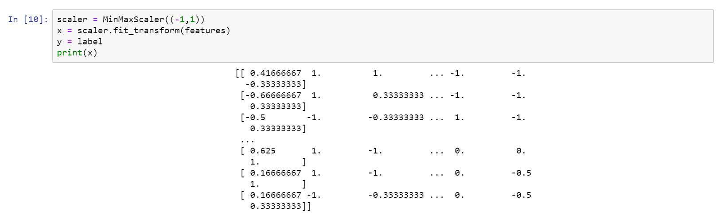
Rescaling data using MinMaxScaler:
Machine learning algorithms are not likely to perform well if the features are not on the relatively similar scale
Use MinMaxScale to transform features by scaling each feature to a given range.
Initialize a MinMaxScaler and scale the features to between -1 and 1

Slide 19
Split dataset:
Split the dataset into 2 sets: training & test set
Keep 20% of the data for testing (test_size = 0.2)
Random_state will act as the seed for the random number generator during the split.

Slide 20
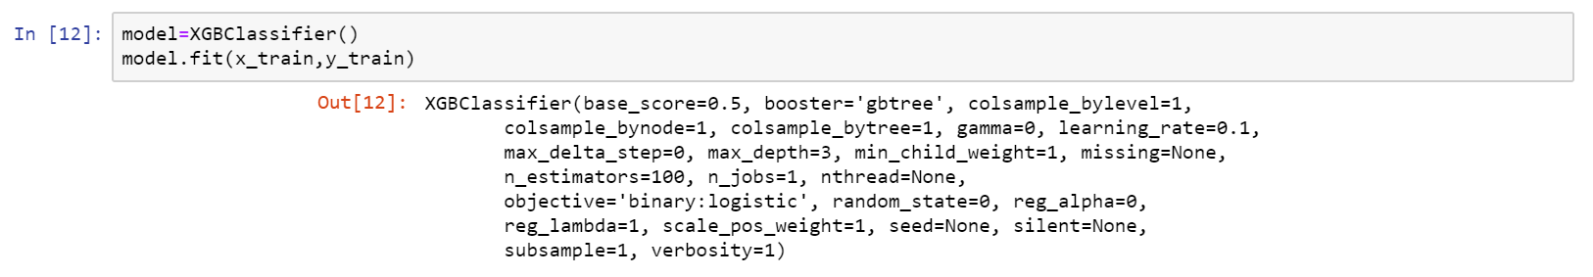
4.4: Train model
4.4.1: XGB Classifier:
Initialise a XGBClassifier and train the model

Slide 21
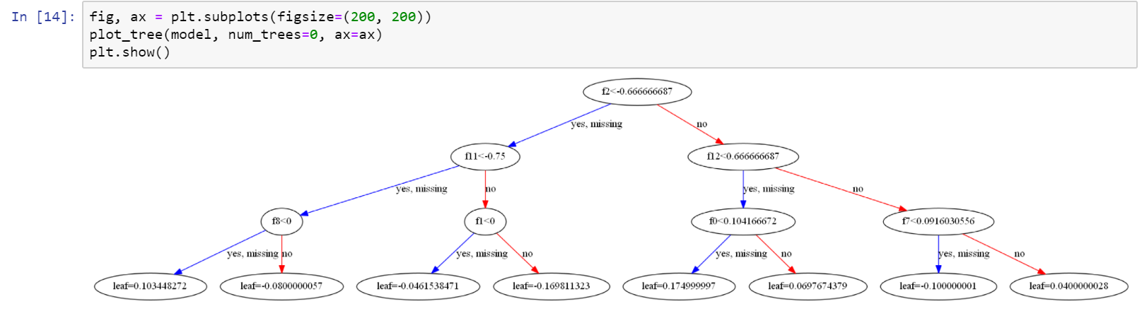
XGBoost:
A decision-tree-based ensemble ML algorithm
Model consists of a class of classification and regression trees (CART)
Visualise a single decision tree in the model using graphviz library:
Visualisation of the first decision tree (tree at index 0)

Slide 22
4.4: Train model
4.4.1 XGB Classifier:
Generate y_pred (predicted value for x_test)
Calculate the accuracy of the model
XGBoost gives an accuracy of approximately 85%

Slide 23
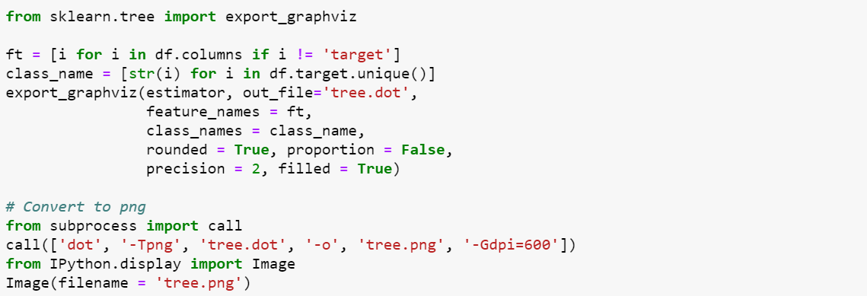
4.4: Train model
4.4.2 Random Forest Classifier:
Initialise model
Visualise single decision tree in the model:

Slide 24
Root node
Leaf nodes

Slide 25
Node information:
Variable and value to split node on
Deciding factor
Number of data points in the node
Number of samples of each class
Prediction for the data points in node

Slide 26
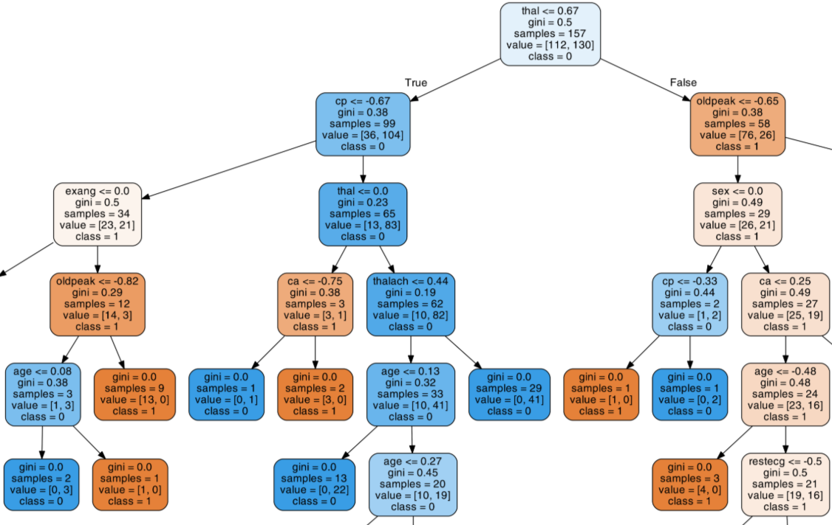
Example: Make prediction for a patient with following data:
-0.5 | -1 | -0.3333 | -0.3207 | -0.6438 | -1 | -1 | 0.5419 | -1 | -0.5483 | 1 | -1 | 0.3333

Slide 27
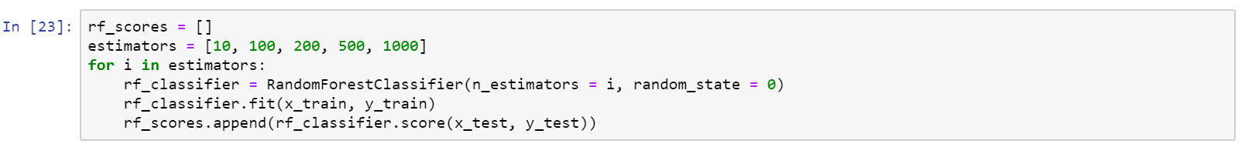
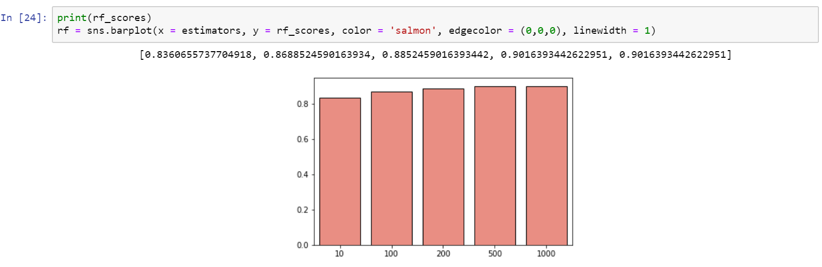
4.2 Train model
4.2.2 Random Forest Classifier:
Vary the number of trees used to predict the class
Calculate the test score of each estimator
Draw bar plot for each estimator:

Slide 28
Summary
This project used 2 machine learning algorithms:
XGBoost: with approximately 85% accuracy
Random forest: with approximately 90% accuracy

Slide 29

Thanks for listening

